Slide 1
A Survey on Federated Learning Improvement Techniques
Presented By:
Aly Ahmad
UCID: 30270758

Slide 2
Agenda
01
02
03
04
Communication
Efficiency
Techniques
Background
Data Heterogeneity Techniques
Client Privacy Techniques

Slide 3
01
Background

Slide 4
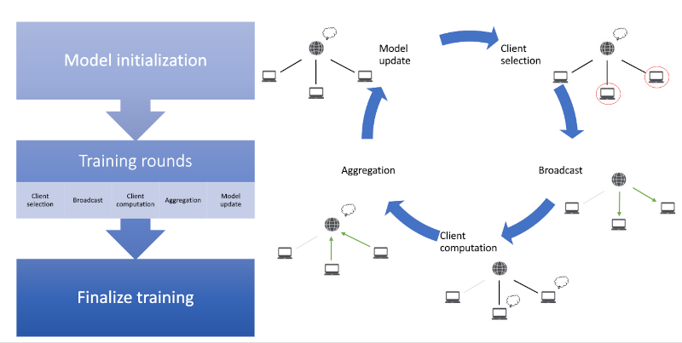
Background: Original FL Paradigm

Slide 5
Background: Original FL Paradigm
Model Initialization:
The server initializes the global model and broadcasts it to all clients.
Client Selection:
A subset of clients is selected for training in each round.
Broadcast:
Selected clients receive the current global model from the server.

Slide 6
Background: Original FL Paradigm
4. Client Computation:
Clients train the model locally using their private data.
5. Aggregation:
The server aggregates client updates to produce an updated global model.
6. Iteration:
Steps 2-5 are repeated for multiple rounds until convergence.

Slide 7
Background: Original FL Challenges
The following challenges exist in the original algorithm of federated learning:
Communication Constraints:
Frequent data transfer between clients and the server introduces high overhead.
Real-world devices often operate with limited bandwidth and computational resources.
Data Heterogeneity:
Client data is Non-Independent and Identically Distributed (Non-IID).
Imbalanced datasets lead to slower convergence and reduced global model accuracy.
Privacy Risks:
Transmission of model updates can potentially reveal sensitive information.
Adversaries may exploit updates for reverse-engineering private data.

Slide 8
02
Communication
Efficiency
Techniques

Slide 9
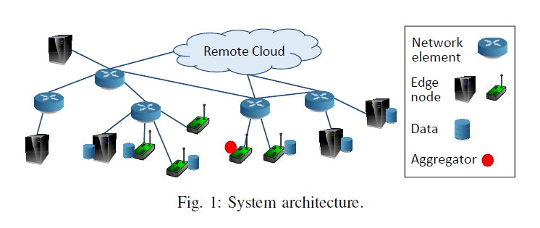
Communication Efficiency: Dynamic Aggregation Frequency
Wang et. al propose a resource-efficient FL algorithm for constrained budgets.
They propose an algorithm to adjust the frequency of local updates and global aggregations in a federated learning system.
Reference: S. Wang, T. Tuor, T. Salonidis, K. K. Leung, C. Makaya, T. He, and K. Chan, “Adaptive federated learning in resource constrained edge computing systems,” IEEE Journal on Selected Areas in Communications, vol. 37, no. 6, pp. 1205–1221, 2019.

Slide 10
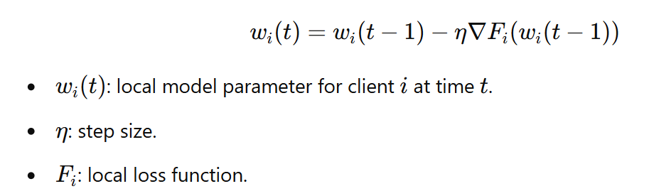
Communication Efficiency: Dynamic Aggregation Frequency
Since Local Model Updates are done as follows:
Aggregation frequency (𝜏) impacts:
Higher 𝜏: Reduced communication but slower model convergence.
Lower 𝜏: Faster convergence but higher communication costs.

Slide 11
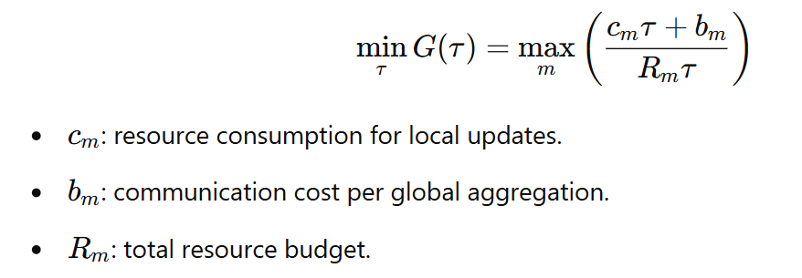
Communication Efficiency: Dynamic Aggregation Frequency
The proposed control algorithm dynamically adapts 𝜏 to minimize:
By minimizing resource consumption, this algorithm is shown to cause near-optimal convergence while preserving resources.

Slide 12
Communication Efficiency: Scalable System Design
This work addresses the following bottlenecks of FL:
Device variability: Differences in availability, bandwidth, and resources.
Dropouts: Devices may fail to report updates.
Bandwidth costs: Transmitting large model updates can overwhelm resources.
Scalability: Handling millions of devices with varying network conditions.
Reference: K. Bonawitz, H. Eichner, W. Grieskamp, D. Huba, A. Ingerman, V. Ivanov, C. Kiddon, J. Koneˇcn´y, S. Mazzocchi, H. B. McMahan, T. V. Overveldt, D. Petrou, D. Ramage, and J. Roselander, “Towards federated learning at scale: System design,” 2019.

Slide 13
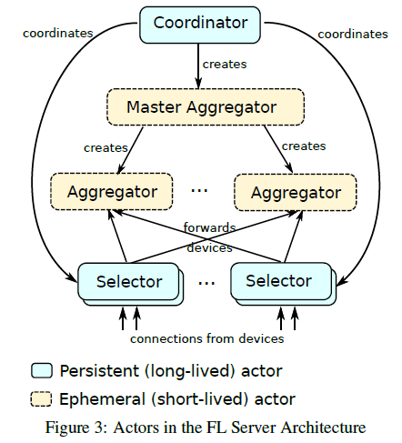
Communication Efficiency: Scalable System Design
This work uses an efficient server architecture:
Coordinator: Manages rounds and creates Master Aggregators.
Master Aggregator: Distributes tasks to Aggregators.
Aggregators: Handle updates from devices in parallel.
Selectors: Manage device connections and filter eligible devices.

Slide 14
Communication Efficiency: Scalable System Design
Other communication efficiency techniques proposed by the paper:
Load Balancing: Selectors manage staggered device check-ins to prevent overload.
Oversampling of devices to compensate for dropouts.
Pipelining: Overlap rounds (e.g., selecting devices for the next round while processing the current one).
Compression: Reduce bandwidth by compressing updates.
Ephemeral Actors: Aggregators are short-lived to minimize resource use.
Geographical Distribution: Deploy Selectors closer to devices to reduce latency.

Slide 15
Communication Efficiency: Quantization and Periodic Avg
This work combines partial client participation and periodic aggregation from FedAvg with Quantization where:
Devices send compressed (quantized) model updates.
Reduces data size transmitted by each device.
Achieves efficient use of limited bandwidth.
Reference: A. Reisizadeh, A. Mokhtari, H. Hassani, A. Jadbabaie, and R. Pedarsani, “Fedpaq: A communication-efficient federated learning method with periodic averaging and quantization,” 2020. [Online]. Available: https://arxiv.org/abs/1909.13014

Slide 16
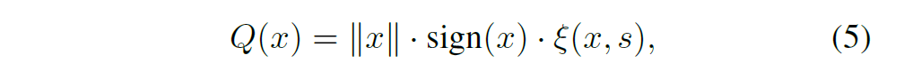
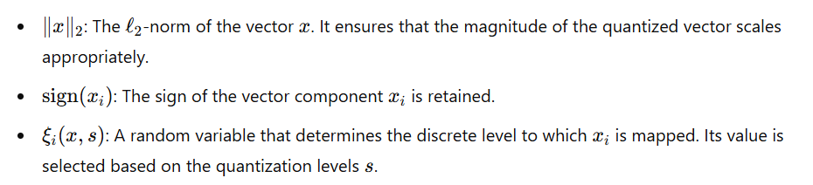
Communication Efficiency: Quantization and Periodic Avg
The paper uses an unbiased low precision quantizer as follows:

Slide 17
Communication Efficiency: Quantization and Periodic Avg
This quantizer is implemented in the provided Github repository and a simulation of quantization in FL can be run by running the following command:
python src/fl_quantized_simulation.py --model=cnn --dataset=cifar --gpu=0 --iid=0 --epochs=10
The following example compares the performance of normal and quantized federated learning when training a CNN on the MNIST dataset, where data is quantized using 64 levels. This leads to a bandwidth optimization of 78.125%

Slide 18
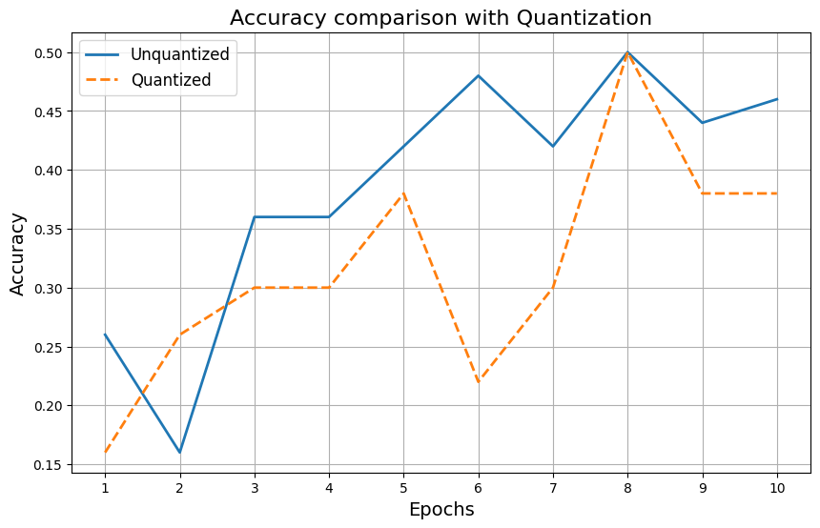
Communication Efficiency: Quantization and Periodic Avg

Slide 19
03
Data Heterogeneity Techniques

Slide 20
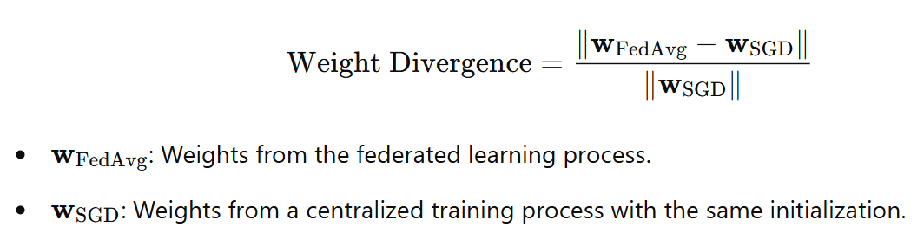
Data Heterogeneity: Weight Divergence
This paper investigates the challenges and solutions for federated learning when local client data distributions are non-IID. Specifically, it introduces a helpful metric called Weight Divergence:
This metric measures the deviation between the weights resulting from federated learning (non-IID distributed data) and centralized learning (IID data).
Reference: Y. Zhao, M. Li, L. Lai, N. Suda, D. Civin, and V. Chandra, “Federated learning with non-iid data,” 2018. [Online]. Available: https://arxiv.org/abs/1806.00582

Slide 21
Data Heterogeneity: One-shot Clustering (k-fed)
This paper performs clustering in only one round of communication while preserving privacy by:
Local Clustering: Each Client clusters its own data locally first.
Local Centroid Gathering: Each Client only sends the centroids of its clusters.
Global Centroid Clustering: The Server uses K-Means to cluster the centroids of all clients.
Reference: D. K. Dennis, T. Li, and V. Smith, “Heterogeneity for the win: One-shot federated clustering,” 2021.

Slide 22
Data Heterogeneity: Personalized FL
Personalized FL is used as a technique to solve problems caused by data heterogeneity. It is divided into two main categories:
Global Model Personalization: Trying to personalize a single global model, such as:
Regularization-Based Methods: Add a proximal term to local objectives (e.g., FedProx).
Meta-Learning Approaches: Use meta-learning techniques (e.g., Per-FedAvg) for rapid adaptation.
Learning Personalized Models:
Parameter Decoupling: Share base layers globally, train upper layers locally.
Weighted Model Aggregation (e.g., FedFomo): Combine personalized weighted models from other clients.
Reference: M. Zhang, K. Sapra, S. Fidler, S. Yeung, and J. M. Alvarez, “Personalized federated learning with first order model optimization,” 2021.

Slide 23
04
Client Privacy Techniques

Slide 24
Privacy in FL
Risks of Privacy in FL:
Sensitive data remains on client devices, but risks exist through model updates.
Potential privacy breaches:
Model update inference.
Unauthorized data reconstruction.
Differential Privacy in FL: Ensures individual contributions do not significantly impact aggregated results
Basic Method: Adds noise to updates to mask individual data points.
Challenges: Balancing privacy with model performance

Slide 25
Privacy in FL: Secure Aggregation
Secure Aggregation: A method to compute the sum of user-held data securely to ensure the server learns only the aggregate sum, not individual data.
Main Steps:
Initialization and Key Exchange
Mask Generation
Data Masking
Aggregation by Server
Reference: K. Bonawitz, V. Ivanov, B. Kreuter, A. Marcedone, H. B. McMahan, S. Patel, D. Ramage, A. Segal, and K. Seth, “Practical secure aggregation for privacy-preserving machine learning,” in Proceedings of the 2017 ACM SIGSAC Conference on Computer and Communications
Security.

Slide 26
Privacy in FL: Secure Aggregation
Initialization and Key Exchange:
Users generate cryptographic keys using ECDH (Elliptic-curve Diffie–Hellman).
Public keys are shared with the server.
Server distributes keys to all users.
Users verify the authenticity of received keys.
Mask Generation
Each pair of users generate a mask to hide individual data contributions.
Each user in the pair holds the same magnitude of the mask but with the opposite sign.
Reference: K. Bonawitz, V. Ivanov, B. Kreuter, A. Marcedone, H. B. McMahan, S. Patel, D. Ramage, A. Segal, and K. Seth, “Practical secure aggregation for privacy-preserving machine learning,” in Proceedings of the 2017 ACM SIGSAC Conference on Computer and Communications
Security.

Slide 27
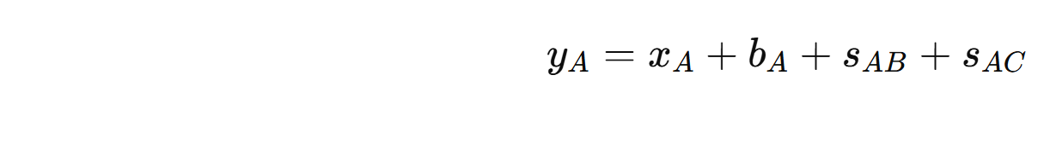
Privacy in FL: Secure Aggregation
3. Data Masking: Each User adds their own public key and their pairwise keys to their weights before sending to the server.

Slide 28
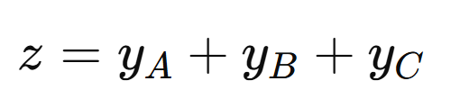
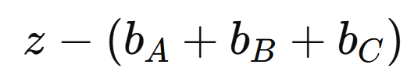
Privacy in FL: Secure Aggregation
4. Aggregation by Server: The server adds all masked values from all users. Then subtracts the public keys from it.
The pairwise keys cancel each other out, since each user in the pair of users adds the pairwise key with a different sign.

Slide 29
Privacy in FL: Secure Aggregation
Benefits of this approach:
Private masks and pairwise masks ensure individual values remain hidden, even if the server intercepts masked values, it cannot deduce private data.
Minimal overhead in computation and communication

Slide 30
Thank You

